Slide 1



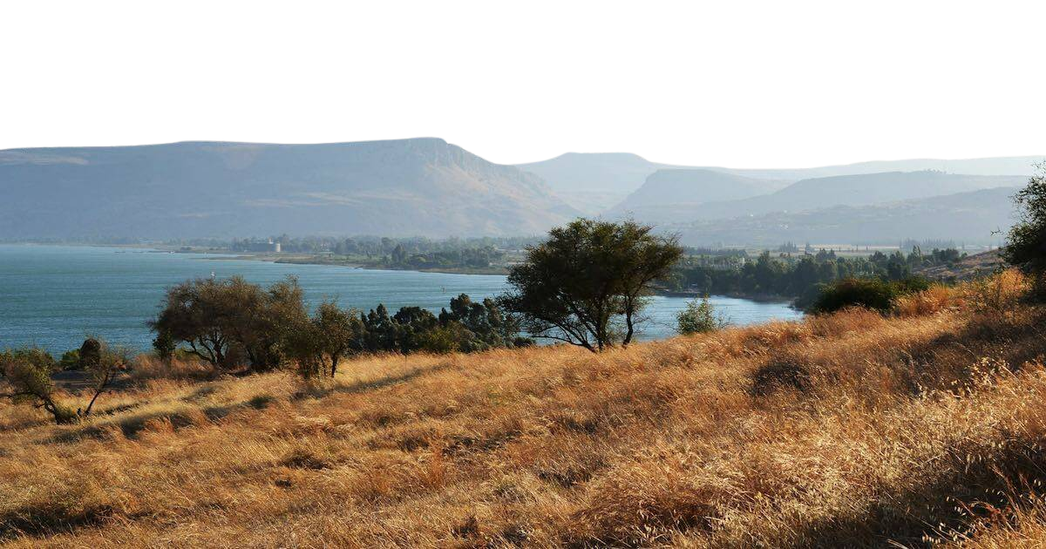

The Good Life:
Matthew 7:1-6

Slide 2
OUR RELATIONSHIP WITH OUR HEAVENLY FATHER [6:1-7:12]

Slide 3
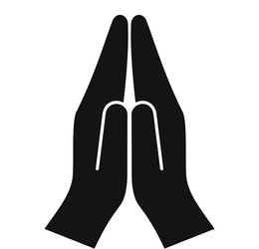
OUR RELATIONSHIP WITH OUR HEAVENLY FATHER [6:1-7:12]
6:1-18
How we do our
good deeds

Slide 4

OUR RELATIONSHIP WITH OUR HEAVENLY FATHER [6:1-7:12]
6:1-18
How we do our
good deeds
6:19-34
How we live in the world

Slide 5

OUR RELATIONSHIP WITH OUR HEAVENLY FATHER [6:1-7:12]
6:1-18
How we do our
good deeds
6:19-34
How we live in the world
7:1-6
How we live as a Community

Slide 6
THE CULTURE OF
THE
JESUS
COMMUNITY

Slide 7
  When the doctrine is clear
  and the culture is beautiful,
  that church will be powerful.
  Ray Ortlund

Slide 8
THE CULTURE OF THE JESUS COMMUNITY
  The Headline: DO NOT JUDGE

Slide 9
DO NOT JUDGE – WHAT IT DOESN’T MEAN

Slide 10
DO NOT JUDGE – WHAT IT DOESN’T MEAN
  Do not have an opinion
  You are the salt of the earth… You are the light of the world (5:13,14)

Slide 11
DO NOT JUDGE – WHAT IT DOESN’T MEAN
  Do not have an opinion
  Do not be discerning
  Watch out for false prophets [7:15]
  Do not give dogs what is sacred; do not throw your pearls to pigs [6:7]

Slide 12
DO NOT JUDGE – WHAT IT DOESN’T MEAN
  Do not have an opinion
  Do not be discerning
  Do not rebuke error
  Rebuke them sharply, so that they will be sound in the faith (Titus 1:13)
  Instruct certain people not to teach different doctrine (1 Timothy 1:3)

Slide 13
DO NOT JUDGE – WHAT IT DOESN’T MEAN
  Do not have an opinion
  Do not be discerning
  Do not rebuke error
  Do not tackle sin
  And let us consider how we may spur one another on toward love and good deeds (Heb 10:24)
  If your brother or sister sins, go and point out their fault, just between the two of you (Matt 18:15)

Slide 14
DO NOT JUDGE – WHAT IT DOESN’T MEAN
  Do not have an opinion
  Do not be discerning
  Do not rebuke error
  Do not tackle sin
  Do not exercise church discipline
  Are you not to judge those inside?...Expel the wicked person from among you. (1 Cor 5:12,13)
  And if they refuse to listen even to the church, treat them as you would a pagan or a tax collector (Matt 18:17)

Slide 15
DO NOT JUDGE – WHAT IT DOES MEAN
  Do not have a critical spirt that condemns others

Slide 16
  Brothers and sisters, do not slander one another. Anyone who speaks against a brother or sister or judges them speaks against the law and judges it. When you judge the law, you are not keeping it, but sitting in judgment on it. There is only one Lawgiver and Judge, the one who is able to save and destroy. But you—who are you to judge your neighbour?
  James 4:11-12

Slide 17
THE CULTURE OF THE JESUS COMMUNITY
  The Headline: DO NOT JUDGE
  The small print: what does this mean in practice?

Slide 18
THE CULTURE OF THE JESUS COMMUNITY
  The Headline: DO NOT JUDGE
  The small print: what does this mean in practice?
  Grace not a gavel (1-2)

Slide 19
THE GRACE OF GOD TO US…
  …we have redemption through his blood, the forgiveness of sins, in accordance with the riches of God’s grace that he lavished on us
  Ephesians 1:7-8
  …We have all received grace upon grace
  John 1:16
  … we have gained access by faith into this grace in which we now stand.
  Romans 5:2

Slide 20
THE GRACE OF GOD TO US…
  There is therefore now no _____________ for those in Christ Jesus
  Romans 8:1

Slide 21
THE GRACE OF GOD TO US…
  There is therefore now no condemnation for those in Christ Jesus
  Romans 8:1

Slide 22
THE CULTURE OF THE JESUS COMMUNITY
  The Headline: DO NOT JUDGE
  The small print: what does this mean in practice?
  Grace not a gavel (1-2)
  Humility before helping (3-5)

Slide 23
HUMILITY BEFORE HELPING
  This does not make us mute, it makes us humbly seek to grow together in love for God and one another, to grow in holiness and justice and to become a society marked by authentic honesty and genuine growth
  Scott McKnight

Slide 24
THE CULTURE OF THE JESUS COMMUNITY
  The Headline: DO NOT JUDGE
  The small print: what does this mean in practice?
  Grace not a gavel (1-2)
  Humility before helping (3-5)

Slide 25
OUR CODE OF CONDUCT FOR DEALING WITH IMPERFECT PEOPLE
  Step 1 – How has my heavenly father treated me

Slide 26
OUR CODE OF CONDUCT FOR DEALING WITH IMPERFECT PEOPLE
  Step 1 – How has my heavenly father treated me
  Step 2 – Move towards the person with grace

Slide 27
OUR CODE OF CONDUCT FOR DEALING WITH IMPERFECT PEOPLE
  Step 1 – How has my heavenly father treated me
  Step 2 – Move towards the person with grace
  Step 3 – Humble yourself

Slide 28
OUR CODE OF CONDUCT FOR DEALING WITH IMPERFECT PEOPLE
  Step 1 – How has my heavenly father treated me
  Step 2 – Move towards the person with grace
  Step 3 – Humble yourself
  Step 4 – Help your brother or sister

